Slide 1

Data Leadership: Navigating Security, Governance, and Ethical Decision-Making in the Digital Skies

Slide 2

Agenda
Introduction Security, Governance, and Ethics Data Security Challenges Data Governance Technology and Tools Case Studies Conclusion

Slide 3
Introduction
Security governance and ethics
Importance of security governance and ethical management
Data Security challenges
Data Governance fundamentals
Ethical decision making in data management
Technologies and Tools
Ethical case studies

Slide 4



About me
Gethyn Ellis
Microsoft, Azure, Power Platform Trainer
www.gethynellis.com
gethyn@gethynellis.com
Twitter: @gethyn_ellis
LinkedIn: https://www.linkedin.com/in/gethynellis/
Notes:
We can help Berry, and we can help you
I have been working in the data space for about 20 years.
In that time I have had a variety of jobs, from report writer, web developer and DBA
For the last 16 years I have been running a small consulting and training business, gethynellis.com, and of late we have partnered with our good friends at Wyeden to offer cost effective end to solutions in the following areas
Data platform architecture and design - including high availability and disaster recovery solutions and obviously how to licence those
Data Architecure and data strategy advice
SQL Server migrations – including upgrades and migrations to a range of cloud solutions
SQL Server health Checks and performance tune ups.
SQL Server and Microsoft Data platform training including the Microsoft Official Curriculum of courses
Critical friend advice on implementing technical and non-technical change
You can follow me on twitter and feel free to look me up and connect with me on LinkedIn – we follow back
If you have any questions on what we discuss in this session today, do feel free to send me an email

Slide 5

Case Study Poll
I want you to rate the three cases studies
Notes:
Get your phones out and scan the QR code – I need to check they are working as we have some interaction later and also I need you to leave feedback. You can win prize

Slide 6

Security, Governance, and Ethics

Slide 7

Berry Wand – Chief Data Officer
Notes:
I like to turn my presentations into a bit of a Story, with characters and real-life problems that you might be experiencing and can resonate with. All characters and organisations used in my presentation are fictional. So with that said let me introduce you to Berry Wand.
Berry Wand was feeling upbeat. She had just secured her first Chief Data Officer Role for Police Force in the UK
A Chief Data Officer (CDO) is a senior executive who is responsible for overseeing the management and governance of an organization's data assets. The role of the CDO has become increasingly important as organizations have come to recognize the value of data as a strategic asset. This is true of Small or large, public or private organisations alike
As the Chief Data Officer for a leading police force, she was in charge of creating a data-driven corporate culture she feels she has all the tools she needed to make it happen. But she needed to figure out where to start; she had a vision, but it was the implementation and delivery of that vision that she needed help with.

Slide 8
Pillars of Trust in Modern Business
Security Governance
Ethical Management
Notes:
In the rapidly changing landscape of modern business, where digital transformation dictates market dynamics, security governance, and ethical management are emerging as critical pillars of organizational integrity and success. With data breaches making headlines and consumers becoming increasingly aware of their data rights, companies are under intense scrutiny to ensure the safety of sensitive information and to conduct business ethically. This introductory article outlines the imperative of integrating robust security governance and ethical management practices into the core of business strategies today.
Security Governance: The Bedrock of Digital Trust
Security governance refers to the set of responsibilities and practices exercised by an organization's board and senior management to provide strategic direction, ensure objectives are achieved, manage risk appropriately, and verify that the organization's resources are used responsibly. In a world where cyber threats are evolving with alarming sophistication, security governance becomes the bedrock upon which businesses can build digital trust with stakeholders.
Ethical Management: Conducting Business with Conscience
Ethical management is the practice of leading and operating an organization in a manner that is considerate of ethical principles and values. It is about making business decisions that are not only legally compliant but also morally sound, taking into account the well-being of employees, customers, the environment, and society at large.

Slide 9
Importance of Security Governance
Definition and Scope
Risk Management and Compliance
Incident Response and Resilience
Notes:
Definition: Security governance encompasses the frameworks and processes that ensure an organization's information assets are protected. It's about strategic direction, managing risk, and ensuring resources are used responsibly.
Risk Management and Compliance
A key component of security governance is the establishment of a risk management framework that aligns with business objectives and regulatory requirements. This framework should address the identification, analysis, and mitigation of risks associated with cyber threats, data privacy, and other security vulnerabilities. Compliance with industry standards and regulations not only avoids legal repercussions but also reinforces an organization's commitment to protecting stakeholder interests.
Incident Response and Resilience
Proactive security governance includes the development of incident response plans that outline how to manage and recover from security breaches. Building resilience against attacks requires not only technology solutions but also strategic foresight and planning to ensure business continuity under adverse conditions.

Slide 10
Ethical Management Principles
Ethical Management: Conducting Business with Conscience
Data Ethics and Privacy
Corporate Social Responsibility (CSR)
Making Decisions with a Conscience
“Doing the right thing even, when nobody is watching”
Notes:
“Doing the right thing even, when nobody is watching”
Ethical management is the practice of leading and operating an organization in a manner that is considerate of ethical principles and values. It is about making business decisions that are not only legally compliant but also morally sound, taking into account the well-being of employees, customers, the environment, and society at large.
Data Ethics and Privacy
In an age where data is a critical asset, ethical management involves instituting policies that govern the ethical collection, use, and sharing of data. Companies must navigate the fine line between leveraging data for business insights and respecting individual privacy rights, ensuring transparency and consent are at the heart of their data practices.
Corporate Social Responsibility
Ethical management extends to the realm of corporate social responsibility (CSR), where businesses acknowledge their broader role in society and make a commitment to positive social and environmental impact. This includes sustainable practices, equitable treatment of employees, and engagement in community development.

Slide 11
Integrating Security and Ethics
A Holistic Approach for Modern Business
Enhancing Brand Reputation
Gaining a Competitive Advantage
Ensuring Long-term Sustainability
Notes:
The integration of security governance and ethical management is paramount for sustaining business in the digital age. A holistic approach where security and ethical considerations inform business strategies can result in:
Enhanced Brand Reputation: Businesses known for robust security practices and ethical conduct enjoy heightened brand loyalty and trust among consumers.
Competitive Advantage: Companies that prioritize these areas often have a competitive edge, attracting customers and top talent who value security and ethics.
Long-term Sustainability: A commitment to security and ethics contributes to the long-term sustainability of a business, fostering a risk-aware and principle-driven culture.

Slide 12

Data Security Challenges
Notes:
What challenges are Berry and her peers facing

Slide 13
Introduction to Data Security Challenges
The Importance of Data Security in the Digital Age
Data likened to new oil
A valuable asset
The fuel that powers AI
Increasing volume of data heightens security challenges.
Need for strategic measures to safeguard data.
Notes:
In an era where data is often likened to the new oil, safeguarding this valuable asset has become a paramount concern for organizations worldwide. As the volume of data generated, collected, and stored by organizations skyrockets, so do the challenges associated with ensuring its security. This article delves into the intricate landscape of data security challenges, examining their sources, implications, and the strategic measures organizations can adopt to fortify their defenses in the face of these growing threats.

Slide 14
The Evolving Landscape of Data Security Challenges
Key Challenges in Data Security
Rapid Technological Advancement
Sophistication of Cyber Attacks
Regulatory Compliance and Data Sovereignty
Insider Threats
Cloud Security
Notes:
Data security encompasses the practices and policies implemented to protect digital information from unauthorized access, disclosure, disruption, modification, or destruction. As technology advances, the complexity and sophistication of cyber threats evolve, presenting a moving target for data security efforts. Key challenges in data security include:
Rapid Technological Advancement: The pace of technological innovation often outstrips the development of security measures, leaving vulnerabilities unaddressed. As organizations rush to adopt new technologies, they may inadvertently expose themselves to new risks.
Sophistication of Cyber Attacks: Cybercriminals are becoming increasingly sophisticated, leveraging advanced techniques such as artificial intelligence and machine learning to carry out their attacks. Phishing, ransomware, and advanced persistent threats (APTs) are just a few examples of the methods used to compromise data security.
Regulatory Compliance and Data Sovereignty: With the introduction of stringent data protection regulations like the GDPR in Europe and CCPA in California, organizations face the challenge of ensuring compliance while managing data across different jurisdictions. Navigating the complex web of regulations can be daunting, especially for organizations operating internationally.
Insider Threats: Not all threats originate from outside the organization. Insider threats, whether intentional or accidental, pose a significant risk to data security. Managing these risks requires a careful balance between securing data and maintaining a trusting workplace environment.
Cloud Security: The shift towards cloud computing, while offering scalability and efficiency, introduces new security concerns. Shared responsibility models, access management, and data privacy in the cloud are complex issues that organizations must address.

Slide 15
Overcoming Data Security Challenges
Strategic Approaches to Enhancing Data Security
Implementing a Zero Trust Architecture
Enhancing Cybersecurity Awareness and Training
Investing in Advanced Security Technologies
Regular Audits and Risk Assessments
Data Privacy and Protection by Design
Notes:
Overcoming the myriad challenges to data security requires a multi-faceted approach, integrating technology, processes, and people-oriented strategies. Organizations can adopt several key measures to strengthen their data security posture:
Implementing a Zero Trust Architecture: Adopting a Zero Trust security model, which assumes that threats could originate from anywhere and therefore, verifies each request as though it originates from an untrusted network, can significantly enhance data security.
Enhancing Cybersecurity Awareness and Training: Regular training programs for employees can mitigate the risk of insider threats and improve the organization's overall security culture. Employees should be made aware of the common tactics used by cybercriminals and trained on how to respond to potential threats.
Investing in Advanced Security Technologies: Leveraging advanced security solutions, including encryption, intrusion detection systems, and behavioral analytics, can provide deeper insights into threats and automate the detection and response to security incidents.
Regular Audits and Risk Assessments: Conducting regular security audits and risk assessments helps organizations identify vulnerabilities and assess their risk exposure. This proactive approach enables timely remediation and fortification of defenses.
Data Privacy and Protection by Design: Incorporating data privacy and security considerations into the design phase of products, services, and processes can ensure that these principles are embedded throughout the organization's operations.

Slide 16

Data Governance
Notes:
the power of data is not without its challenges, necessitating a robust framework for its governance. Data governance refers to the collection of practices, policies, and standards that ensure the effective and efficient management of data assets across an organization. This article delves into the core principles of effective data governance, offering insights into how organizations can harness the full potential of their data while ensuring compliance, quality, and security.

Slide 17

Introduction to data governance
Introduction to Data Governance
The Fundamentals of Data Governance
A Pathway to Effective Management
Notes:
The Essence of Data Governance
Data governance integrates data management, security, quality, and compliance efforts to ensure that data is accurate, available, secure, and used in alignment with its intended purpose and organizational values. It involves a collaborative effort across various departments within an organization, including IT, legal, finance, and business operations, to establish a unified approach to managing data assets. The fundamental objective of data governance is to enable organizations to extract value from their data while mitigating the risks associated with data management and compliance.

Slide 18

The Core Principles of Data Governance
Core Principles of Effective Data Governance
Data Stewardship and Ownership
Data Quality
Data Security and Privacy
Notes:
The effectiveness of a data governance program hinges on the adherence to several key principles. These principles serve as the foundation for developing and implementing data governance frameworks that align with organizational goals and regulatory requirements.
1. Data Stewardship and Ownership
Clear delineation of data ownership and stewardship roles is crucial for effective data governance. Data owners are typically senior executives who are accountable for data assets within their domain, while data stewards are responsible for the day-to-day management of data, ensuring its accuracy, completeness, and compliance with policies and standards.
2. Data Quality
Data governance must prioritize the maintenance of high data quality standards. This involves establishing processes for continuous data cleaning, validation, and reconciliation to ensure that data is accurate, complete, and reliable for decision-making purposes.
3. Data Security and Privacy
Protecting sensitive data from unauthorized access and ensuring privacy compliance are fundamental aspects of data governance. This requires implementing robust security measures, such as encryption, access controls, and regular security audits, as well as adhering to relevant data protection regulations.
4. Data Lifecycle Management
Effective data governance encompasses managing the entire lifecycle of data, from creation and acquisition through to archival and deletion. This includes defining policies for data retention, storage, archiving, and disposal in compliance with legal and regulatory requirements.

Slide 19
Ensuring Compliance and Promoting Transparency
Sustaining Governance: Compliance and Transparency
Data Lifecycle Management
Regulatory Compliance
Transparency and Accountability
Collaboration and Communication
Notes:
5. Regulatory Compliance
Organizations must ensure that their data governance practices comply with applicable laws, regulations, and industry standards. This includes being transparent about data collection and use, obtaining necessary consents, and responding appropriately to data breaches.
6. Transparency and Accountability
Data governance should promote transparency in how data is managed, used, and shared within and outside the organization. This includes establishing clear policies, documenting processes, and ensuring that stakeholders understand their roles and responsibilities in the governance framework.
7. Collaboration and Communication
Effective data governance requires collaboration and communication across departments and teams. Establishing cross-functional governance bodies, such as a data governance council, can facilitate decision-making, policy development, and issue resolution.

Slide 20

Technology and Tools
Notes:
What tools and technology can help here?
I think the key to remember that while the technology will help it can’t do it for you, you will need to get the people and processes in place to manage your security and governance.

Slide 21
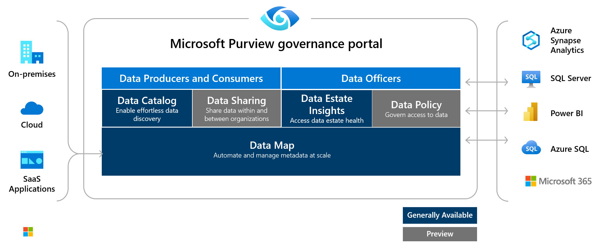
What is Purview
Notes:
Microsoft Purview is a unified data governance service that helps you manage and govern your on-premises, multi-cloud, and software-as-a-service (SaaS) data. Easily create a holistic, up-to-date map of your data landscape with automated data discovery, sensitive data classification, and end-to-end data lineage. Empower data consumers to find valuable, trustworthy data.
The Microsoft Purview governance portal allows you to:
Create a holistic, up-to-date map of your data landscape with automated data discovery, sensitive data classification, and end-to-end data lineage.
Enable data curators to manage and secure your data estate.
Empower data consumers to find valuable, trustworthy data.
The main elements are the Microsoft Purview Data Map, Purview Data Catalog, and Purview Data Estate Insights. Microsoft Purview Data Map powers the Purview Data Catalog and Purview Data Estate Insights as unified experiences within the Microsoft Purview governance portal.

Slide 22
How Microsoft Purview Works
Register sources
Scan and classify
View Data Map
Search
Notes:
The core operational theory:
1) Load data in the Data Map
Register and scan data sources at collection level. Use out-of-the-box or custom scan rules.
View in Data Map
2) Browse and search information
Before you can register and scan data, it’s important to understand the concept of collections. In Microsoft Purview Data Catalog, collections are key concept because they drive permissions and asset protection. Collections are also used to understand data estate health and catalog usage and adoption.
To hydrate the data map, you need to register and scan your data sources, which is done at the collection level. Collections support organizational mapping of metadata. By using collections, you can manage and maintain data sources, scans, and assets in a hierarchy instead of a flat structure.
Data sources are registered and scanned in the Purview governance portal
Each data source will have specific requirements for authenticating and configuration, to permit scanning of the assets in that data source.
Metadata is used to help classify the data that is being scanned and made available in the catalog. The classification rules fall under 5 major categories:
Government - covers attributes such as government identity cards, driver license numbers, passport numbers, etc.
Financial - covers attributes such as bank account numbers or credit card numbers.
Personal - personal information such as a person's age, date of birth, email address, phone number, etc.
Security - attributes like passwords that may be stored.
Miscellaneous - attributes not covered in the other categories.
After registering sources, you’ll organize them into Collections. Collections are a way of grouping data assets into logical collections, to simplify management and discovery of assets within the catalog.
Collections can then be viewed in the data map.

Slide 23
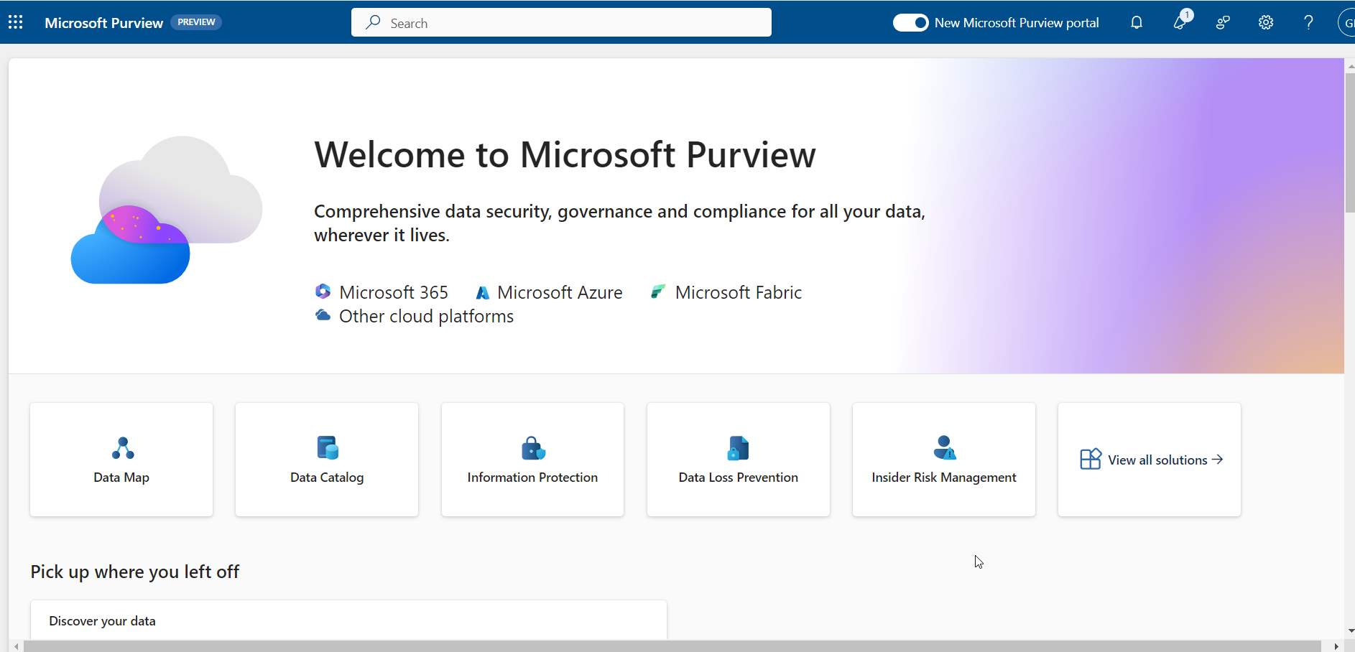

Slide 24
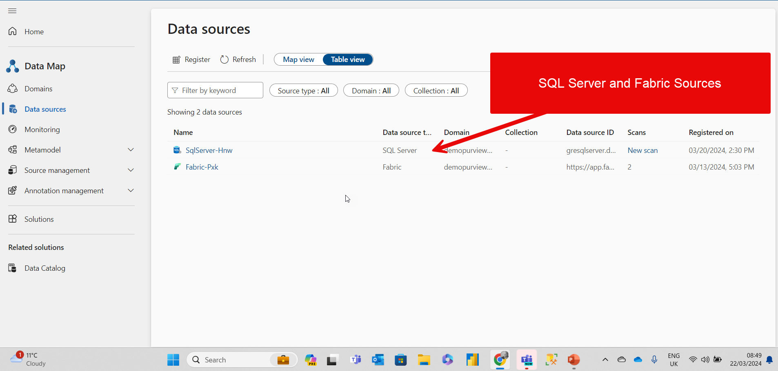

Slide 25
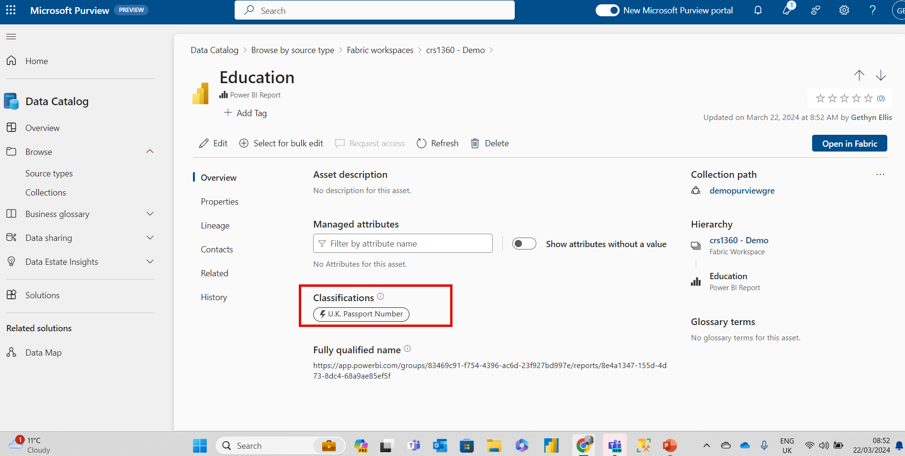
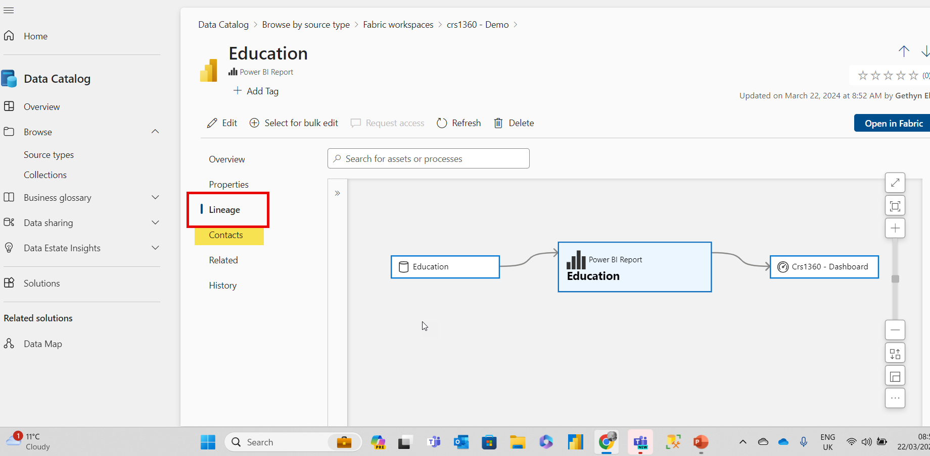
Data Catalog

Slide 26
Use cases
Discovery
If there’s no central location to register data sources, users might be unaware of a data source unless they come into contact with it as part of another process.
Governance
Compliance with company security policies, government regulations, and customer needs, are critical considerations for data governance.

Slide 27
Other technologies
Microsoft Defender
Microsoft Sentinel
Notes:
his response isn't based on the presentation: Microsoft Defender is an antivirus software developed by Microsoft. It provides real-time protection against software threats like viruses, malware, and spyware across email, apps, the cloud, and the web. Microsoft Defender is built into the latest versions of Windows and helps guard your PC against viruses and other malware. It is a free, powerful, and easy-to-use tool that helps protect your device and personal data from malicious attacks.
Microsoft Sentinel is a cloud-native Security Information and Event Management (SIEM) solution developed by Microsoft. It provides intelligent security analytics and threat intelligence across the enterprise, providing a single solution for alert detection, threat visibility, proactive hunting, and threat response. Microsoft Sentinel uses scalable machine learning algorithms to minimize false positives and enhance threat detection capabilities. It is designed to integrate with other Microsoft security solutions and third-party security products to provide a comprehensive security solution for modern enterprises.

Slide 28

Ethical Considerations in Data Handling and Management
Respecting individual autonomy beyond legal requirements: Privacy and Consent
Commitment to accuracy for well-being and fairness: Data Accuracy and Quality
Identifying and mitigating biases in data practices: Fairness and Non-Discrimination
Notes:
When handling data, it is important to consider the ethical implications of our actions. This means going beyond the legal requirements and respecting individual autonomy. We must also be committed to accuracy for the well-being and fairness of all parties involved. Additionally, it is important to identify and mitigate biases in data practices to ensure fairness and non-discrimination. By considering these ethical principles, we can build trust and accountability in our data handling and management practices.

Slide 29
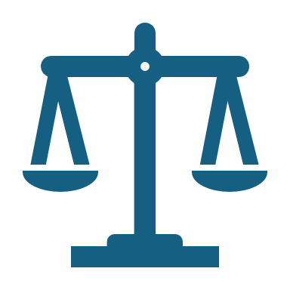
Ethical Considerations in Data Handling and Management
Notes:
the management and handling of data go beyond mere technical and regulatory compliance challenges. At the heart of data management lies a complex web of ethical considerations. These considerations reflect the responsibility organizations have towards individuals whose data they process, as well as society at large. Ethical decision-making in data management is not just about adhering to laws and regulations; it's about respecting privacy, ensuring fairness, and fostering trust. This article explores the ethical considerations in data handling and management, illuminated by real-world case studies.

Slide 30
Ethical Considerations in Data Handling and Management
Privacy and Consent: Respecting individual autonomy beyond legal requirements.
Data Accuracy and Quality: Commitment to accuracy for well-being and fairness.
Fairness and Non-Discrimination: Identifying and mitigating biases in data practices.
Notes:
Speaker Notes:
Privacy and Consent
One of the primary ethical considerations is respecting the privacy of individuals. This involves not only adhering to privacy laws but also going beyond legal requirements to ensure that data is collected, used, and shared in ways that respect individual autonomy. Informed consent is a cornerstone of ethical data management, implying that individuals are fully aware of how their data will be used and have willingly agreed to this use.
Data Accuracy and Quality
Ensuring data accuracy and quality is an ethical obligation. Inaccurate data can lead to harmful decisions, affecting individuals' lives and well-being. Organizations must implement rigorous data verification processes and allow individuals the opportunity to correct inaccuracies in their data.
Fairness and Non-Discrimination
Data-driven decisions can inadvertently perpetuate bias and discrimination. Ethical data management requires active measures to identify and mitigate biases in data collection, analysis, and decision-making processes. Ensuring fairness involves scrutinizing algorithms and models for potential biases and ensuring that data practices do not disadvantage any individual or group.

Slide 31
Building Trust: Transparency and Accountability in Data Practices
Transparency: Being open about data collection, use, and sharing practices.
Accountability: Addressing issues promptly and responsibly when they arise.
Notes:
Transparency and Accountability
Transparency in data practices fosters trust and accountability. Organizations should be open about their data practices, including how they collect, use, and share data. When things go wrong, as they inevitably sometimes will, taking responsibility and addressing the issue promptly is vital.

Slide 32

Case Studies
Notes:
Lets have a look at some use cases – in relation to ethics and the police in particular

Slide 33
Case Study Poll
I want you to rate the three cases studies
Notes:
Phones out time

Slide 34
Case Study 1 Ensuring Data Accuracy in Criminal Records
Ensuring Data Accuracy in Criminal Records
Audit reveals inaccuracies in criminal records database.
Initiatives for improving data accuracy: verification software, routine data reviews, data literacy campaigns.
Significant improvement in public trust and reduction in wrongful arrests.
Notes:
Ensuring Data Accuracy in Criminal Records
Background: Berry Wand, the Chief Data Officer of the Metropolitan Data Police Force (MDPF), faces a significant challenge when an audit reveals a pattern of inaccuracies in the criminal records database. These inaccuracies have led to wrongful arrests and misidentification of individuals, undermining public trust in the police force.
Challenge: Berry must lead the initiative to significantly improve data accuracy and quality in the criminal records system. This involves identifying the root causes of inaccuracies, which range from manual data entry errors to outdated information that hasn't been properly updated.
Action Taken: Berry initiates a comprehensive data quality improvement program that includes:
Implementing advanced data entry verification software to minimize manual errors.
Establishing a routine data review process, engaging both AI technology and human oversight to identify and correct outdated or incorrect information.
Launching a data literacy campaign within the force to emphasize the importance of accuracy in data handling and reporting.
Outcome: Over time, the accuracy of the criminal records database improves significantly, leading to fewer wrongful arrests and a noticeable improvement in public trust. The MDPF becomes a model for other police forces in the UK, with Berry Wand sharing insights and strategies at national law enforcement data management conferences.

Slide 35
Case Study 2: Predictive Policing
Case Study 2: Balancing Privacy and Public Safety
Introduction of a predictive policing system.
Ethical review, transparent framework, and oversight mechanism implementation.
Success in deploying the system with community support.
Notes:
Case Study 2: Balancing Data Privacy with Public Safety in Predictive Policing
Background: The MDPF, under Berry Wand's data leadership, is considering implementing a predictive policing system that uses data analytics to anticipate crimes before they occur. While the system promises to enhance public safety, it raises significant data privacy and ethical concerns, particularly regarding the potential for bias and discrimination.
Challenge: Berry is tasked with ensuring that the predictive policing system respects individuals' privacy rights and does not unfairly target specific communities. This requires a delicate balance between leveraging data for public safety and upholding ethical data management practices.
Action Taken: Berry leads a task force that includes data scientists, ethicists, and community representatives to:
Conduct a thorough ethical review of the predictive policing system, examining potential biases in data sources and algorithms.
Develop a transparent framework for the system's operation, including clear guidelines on data collection, use, and sharing, as well as measures to protect individual privacy.
Implement an oversight mechanism to regularly audit the system's decisions, ensuring they are fair and non-discriminatory.
Outcome: The MDPF successfully deploys the predictive policing system with strong community support, thanks to its commitment to transparency, privacy, and fairness. Berry's leadership in navigating the ethical complexities of predictive policing sets a benchmark for other law enforcement agencies.

Slide 36
Case Study 3 The Community Sentinel Initiative
Background:
Launched by Berry Wand.
Aims to use data to improve police-community relations.
Challenge:
Public perception of police was worsening.
Lack of engagement with community leaders.
Community sentiment data was underutilized.
Action:
Data-driven community outreach program developed.
Used data from community surveys, social sentiment analysis, and town halls.
Outcome:
Neighborhood watch programs created with data insights.
40% improvement in public trust.
Data collection model adopted by other cities.
Notes:
Case Study 3: The Community Sentinel Initiative
Background: To tackle the issues of community policing and engagement, Berry Wand launched the Community Sentinel Initiative, a program designed to utilize data to improve police-community relations.
Challenge: The public perception of the police force was deteriorating, exacerbated by a lack of engagement with community leaders and residents. Data on community sentiments was either not collected or not utilized effectively.
Action: Wand’s team developed a data-driven community outreach program. They aggregated data from community surveys, social media sentiment analysis, and local town hall meetings to guide police community strategies.
Outcome: The Community Sentinel Initiative led to the formation of neighborhood watch programs informed by data insights, fostering stronger community ties. The initiative saw a 40% improvement in public trust ratings, and the community data collection model was adapted by police forces in other cities.

Slide 37

Summary
The current landscape
Importance of security governance and ethical management
Understand the landscape
Security challenges
Governance fundamentals
Ethical decision making in data management
Leadership in Action
Building a Culture of Data Protection and Ethics
Challenges of data leadership
Strategies for data management
Technologies and Tools

Slide 38

Please leave your feedback

